Slide 1

Online health status detection of a motor
MAS513-Advanced Robotics project:
PROBLEM: Is it possible to determine the health status of the motor continuously using non-contact sensors and non-destructive testing?
Gianluca Salata, 25/08/2021

Slide 2
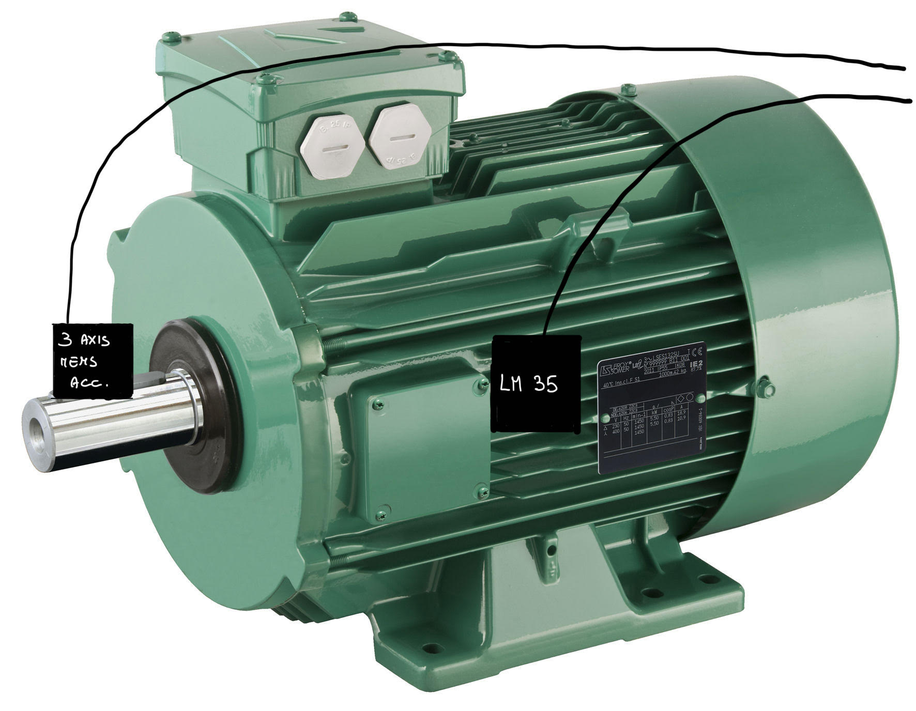
State of art:
Detection of the health status of the motor using contact sensor such as:
Temperature sensor
Vibrometer/accelerometer
Voltmeter and ammeters.
Estim.
useful
life
The vibration of the shaft is related to defects of the inner components of the motor, i.e. bearings. Each harmonics is associated to a specific fault.
Temperature
bearings
defects
Gianluca Salata, 25/08/2021

Slide 3
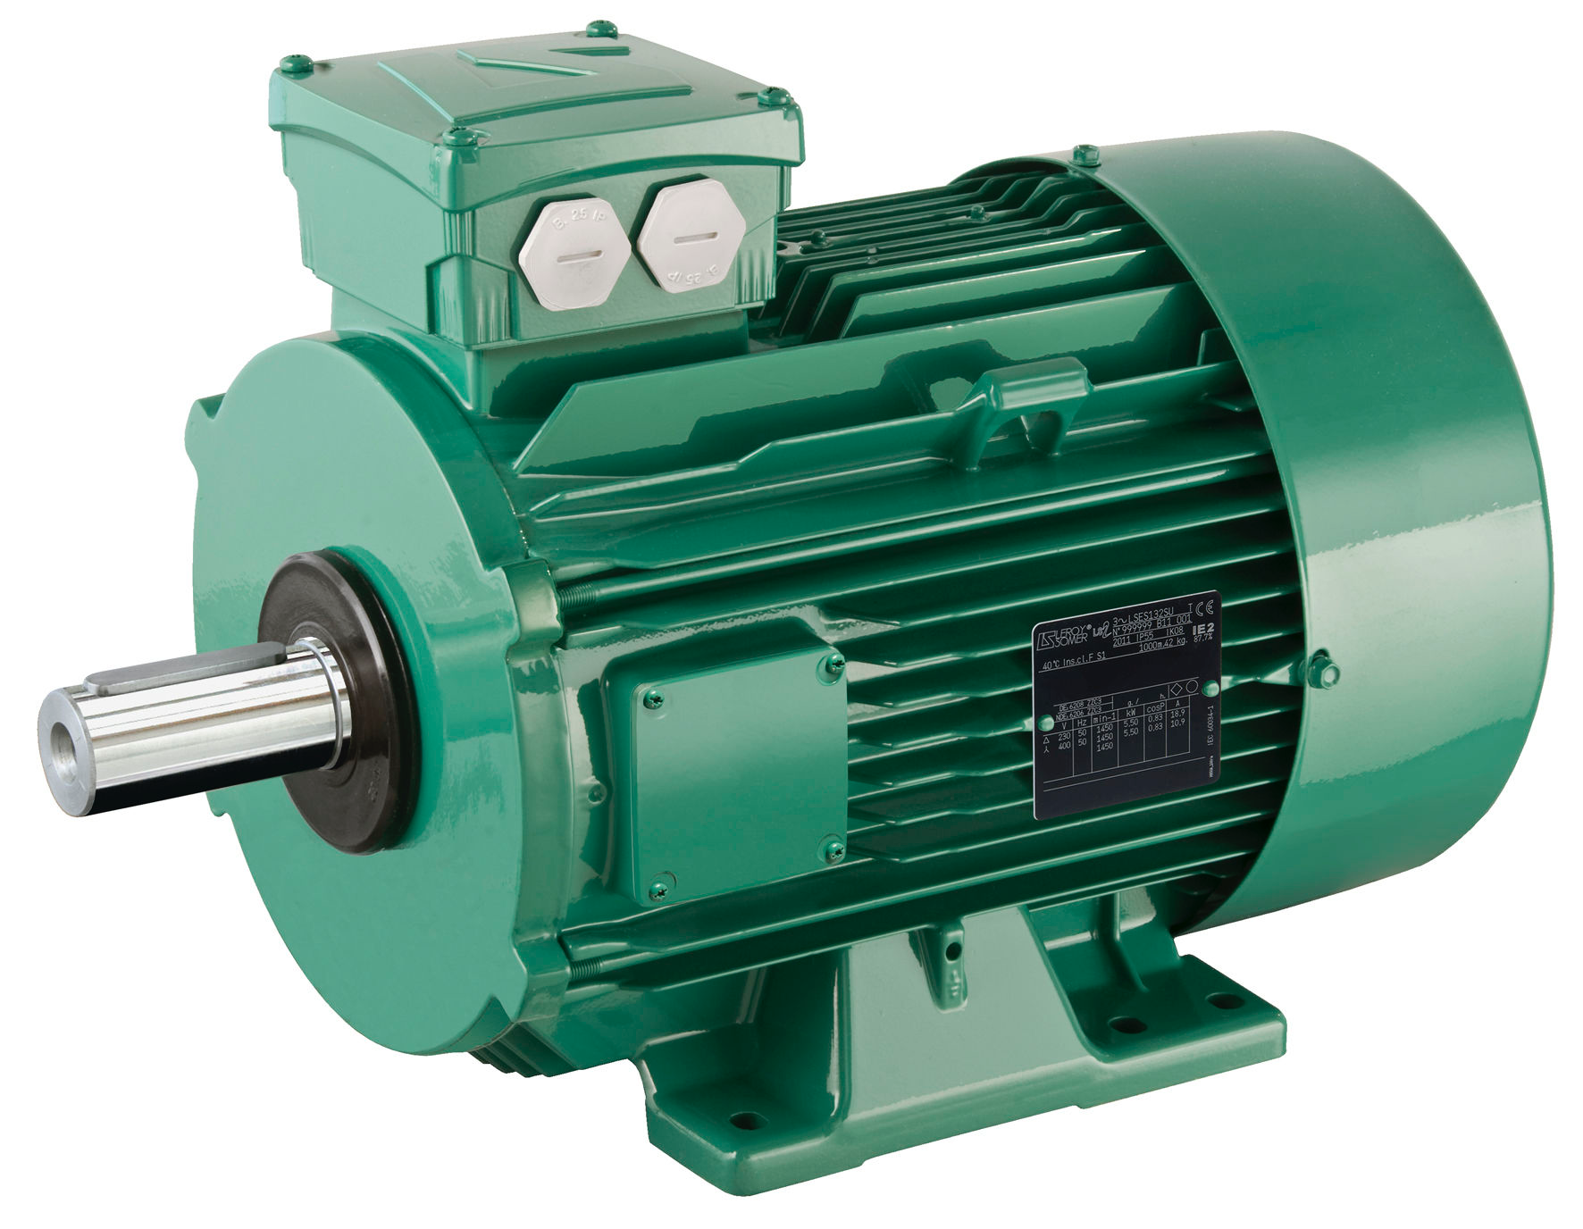
Project’s aim
The aim is to determine the continous health status of the motor using a non-contact sensors that measure the vibration of the shaft.
LIDAR
PROS:
Non intrusive monitoring system
Mostly independet from enviroment condition
Retrace the fault
CONS:
Exspensive
More complex
GOOD
PC
BAD
Gianluca Salata, 25/08/2021

Slide 4
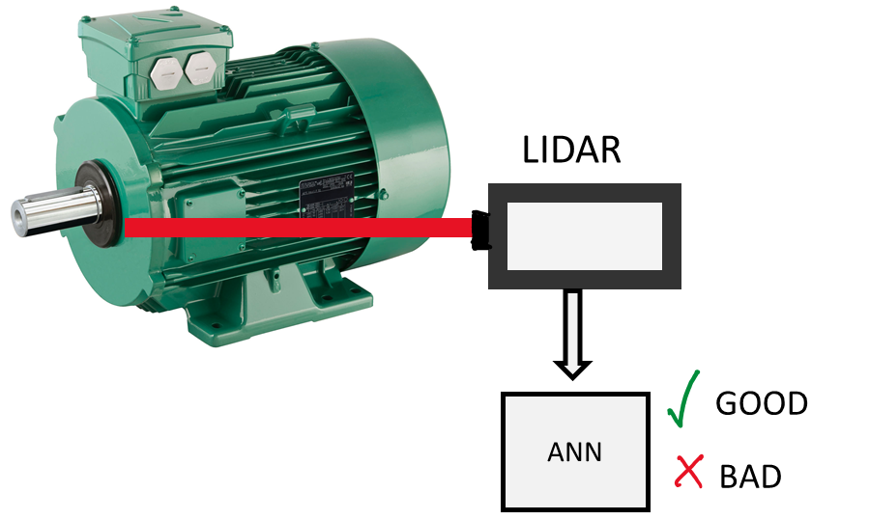
Process
CWFM Lidar generates a voltage signal
Fourier trasformaton of the signal to obtain the range o the shaft
Plotting istantenous range with time we obtain the displacement
PC
Analysing harmonics of the displacement to detect known fault
Gianluca Salata, 25/08/2021

Slide 5
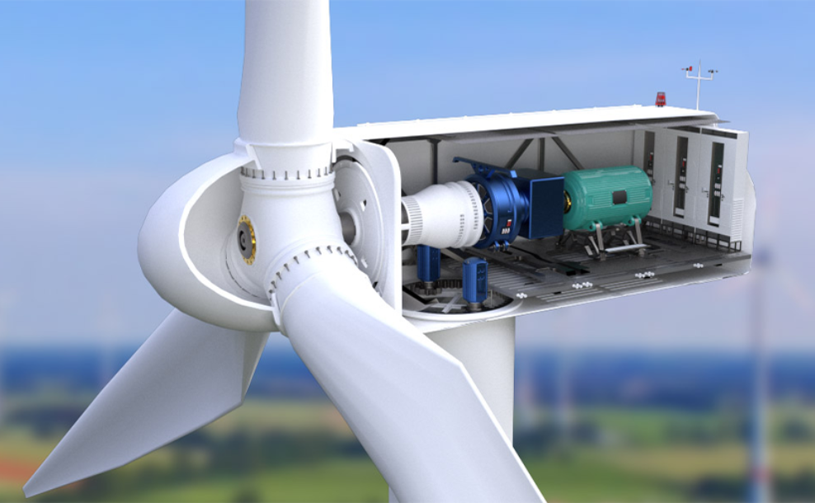
Future applications and developments
Condition monitoring without contact with the object can be very useful when the motor is placed in hostile or not very accesable enviroment.
The data from the sensing components can be used for the control system of the motor, improving efficiency.
The health of the motor can helps to develop new predictive maintenance technique, reducing the costs of industrial installations.
Gianluca Salata, 25/08/2021

